Slide 1
Python Projects in Applied Statistics

Slide 2
Class Materials
Fork the Github repository
Fork the Kaggle kernel & Dataset

Slide 3
Introduction to Python
Installing Python (Anaconda) or Use on the fly kernel (e.g. kaggle)
Login to your kaggle account

Slide 4
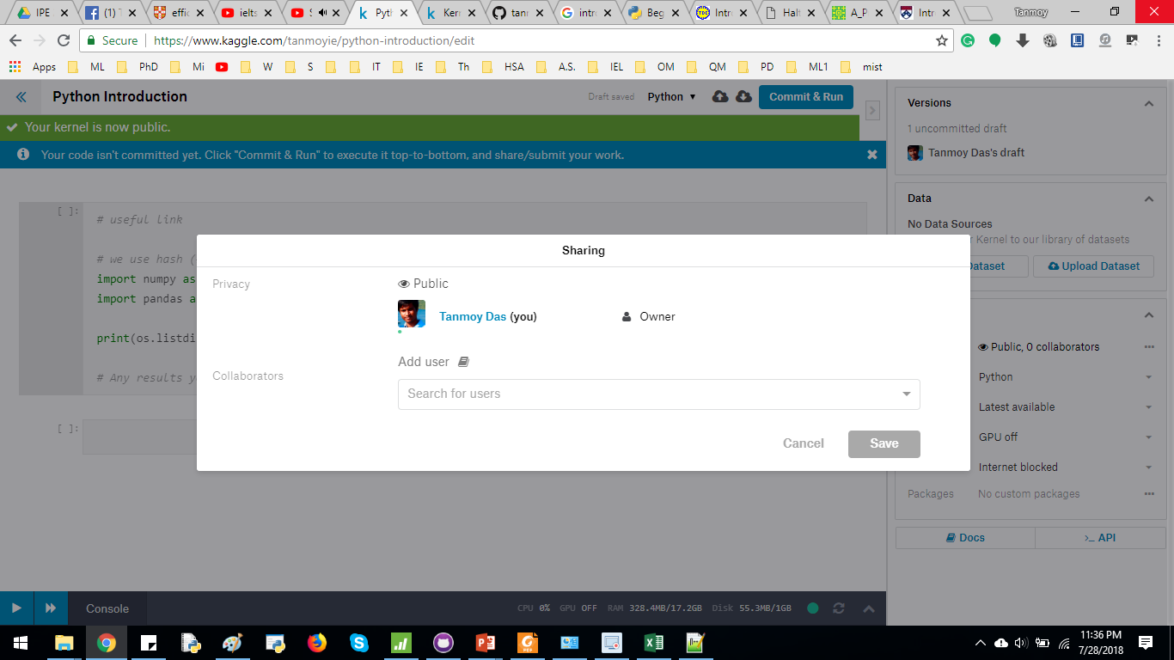
Introduction to Kaggle kernel
Once logged in, click KERNEL at the top right corner, then click NEW KERNEL
From the RIGHT side bar, make the KERNEL “public”. Add tanmoyie as an user/contributor

Slide 5
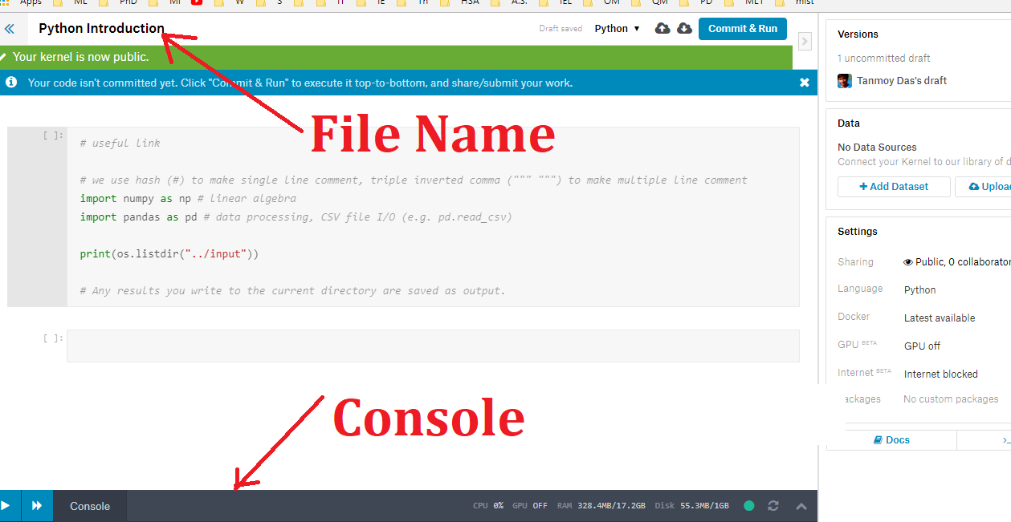
Introduction to Kaggle kernel
Name the file
There is a console in the bottom left corner

Slide 6
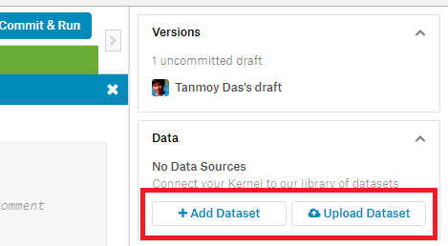
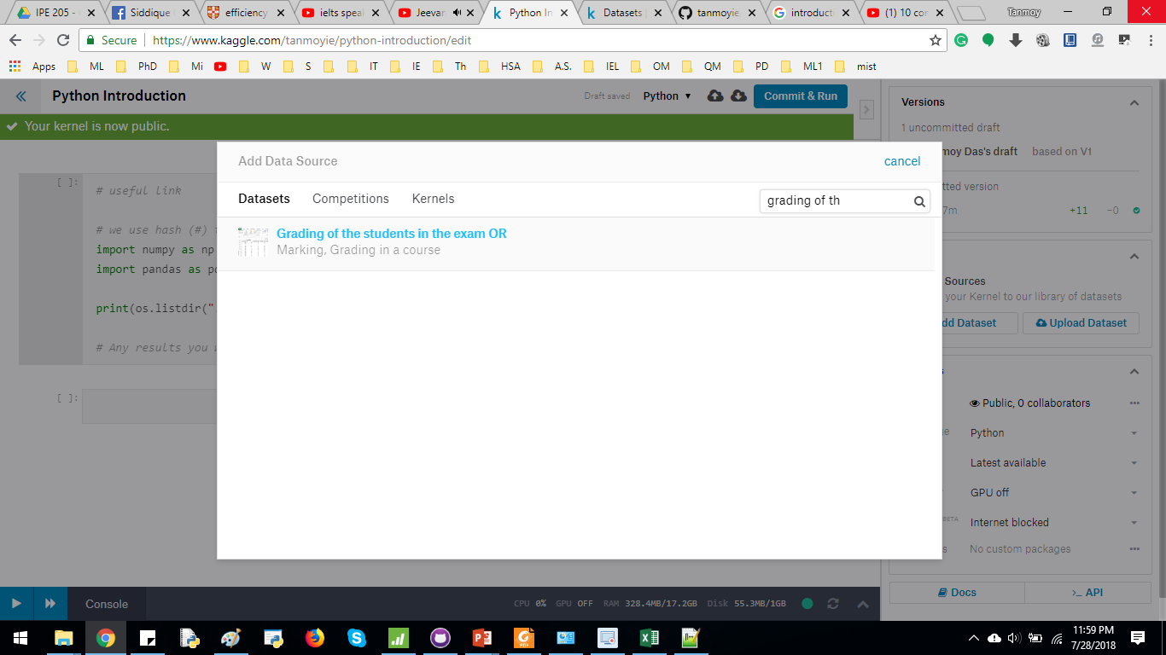
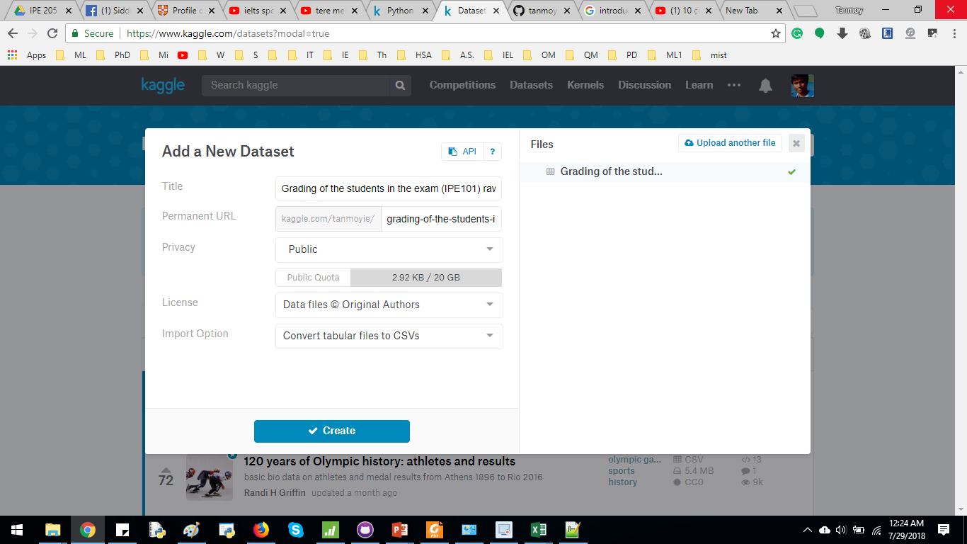
Introduction to Kaggle kernel
You can upload a new dataset from right hand side bar. Additionally, you can use someone else’s dataset (add Dataset)

Slide 7
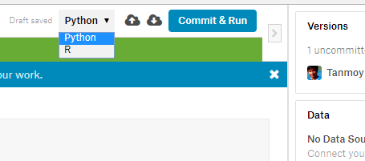
Introduction to Kaggle kernel
Select the Programming language (Python/R)
Commit & Run to run the entire program & make it visible to public.
2 Arrows to add cell above & below the current cell respectively.

Slide 8
Methodology
Data Import
Data Preprocessing
Cleaning
Imputation
Exploratory Data Analysis (EDA)
Develop graphical representation
Interpret the Data

Slide 9
Import an EXCEL file
Install pandas

Slide 10
Collect the Data
Show how I prepare the uploaded dataset
steps from EMS, copy+paste in new Excel file, processing, save as csv

Slide 11
Data Cleaning
Find empty cells or unnecessary cells
Delete unnecessary row/column
https://pandas.pydata.org/pandas-docs/stable/generated/pandas.DataFrame.dropna.html

Slide 12
Data Cleaning (if needed)
Removing unnecessary information
Data Imputation (if needed)
Handling NaN values

Slide 13
# https://github.com/tanmoyie/Applied-Statistics
import numpy as np # linear algebra
import pandas as pd # data processing, CSV file I/O (e.g. pd.read_csv)
# Input data files are available in the "../input/" directory.
# For example, running this (by clicking run or pressing Shift+Enter) will list the files in the input directory
import os
print(os.listdir("../input"))
# ploting related libraries
import matplotlib.pyplot as plt
import plotly.plotly as plty
import plotly.graph_objs as go
#modeling
from sklearn import datasets, linear_model
# load the EXCEL file & read the data
dataframe1 = pd.read_csv("../input/Grading of the students in the exam (OR).csv")
print(dataframe1)
print(dataframe1.dtypes)
input_data = dataframe1.values
input_data_asMatrix = dataframe1.as_matrix()
# Examine the properties of the dataset
# print the statistics
print(dataframe1['Final Mark'].describe())
# Replacing NaN values
input_adding_roll = dataframe1.iloc[3,10]
print(input_adding_roll)
dataframe1.iloc[3,10] = 15
print(dataframe1.values)
# Develop a Scatter plot of Attendance vs the mark of final exam
print("-------------Draw a Scatter Plot: Attendance vs Total Mark -----------")
x = input_data[:,7] # independent variable
y = input_data[:,12] # dependent variable
plt.scatter(x,y) # Scatter plot for Attendance vs Final exam mark
plt.show()
# Develop a Scatter plot of class test vs the mark of final exam
print("-------------Draw a Scatter Plot: Class Test vs Total Mark -----------")
#y_final_exam_sum = input_data['']+input_data[:,11]
x_ct = input_data[:,6] # independent variable
y_final_exam = input_data[:,12] # dependent variable
plt.scatter(x_ct, y_final_exam) # Scatter plot for Attendance vs Final exam mark
plt.show()
# basic plot
dataframe1.boxplot()
# https://pandas.pydata.org/pandas-docs/version/0.23/generated/pandas.DataFrame.hist.html
dataframe1.hist()

Slide 14
Exploratory Data Analysis (EDA) Explanation of Python code

Slide 15
Importing necessary libraries
# https://github.com/tanmoyie/Applied-Statistics
# import the libraries
import numpy as np # linear algebra
import pandas as pd # data processing, CSV file I/O (e.g. pd.read_csv)
import os
print(os.listdir("../input"))
# ploting related libraries
import matplotlib.pyplot as plt

Slide 16
Load EXCEL file & check the data
# load the EXCEL file & read the data
dataframe1 = pd.read_csv("../input/Grading of the students in the exam (OR).csv")
print(dataframe1)
print(dataframe1.dtypes)
input_data = dataframe1.values
# Examine the properties of the dataset
# print the statistics
print(dataframe1['Final Mark'].describe())

Slide 17
Handling NA values (Data Imputation)
# Replacing NaN values
input_adding_roll = dataframe1.iloc[3,10]
print(input_adding_roll)
dataframe1.iloc[3,10] = 15
print(dataframe1.values)

Slide 18
# Develop a Scatter plot of Attendance vs the mark of final exam
print("-------------Draw a Scatter Plot: Attendance vs Total Mark -----------")
x = input_data[:,7] # independent variable
y = input_data[:,12] # dependent variable
plt.scatter(x,y) # Scatter plot for Attendance vs Final exam mark
plt.show()
# Develop a Scatter plot of class test vs the mark of final exam
print("Draw a Scatter Plot: Class Test vs Total Mark -----------")
x_ct = input_data[:,6] # independent variable
y_final_exam = input_data[:,12] # dependent variable
plt.scatter(x_ct, y_final_exam) # Scatter plot for Attendance vs Final exam mark
plt.show()
dataframe1.boxplot()
dataframe1.hist()

Slide 19
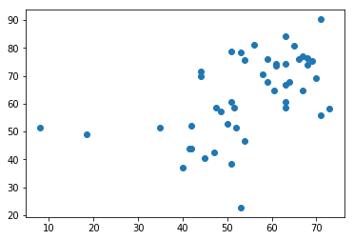
Scatter Plot
# Develop a Scatter plot of Attendance vs the mark of final exam
print("-------------Draw a Scatter Plot: Attendance vs Total Mark -----------")
x = input_data[:,7] # independent variable
y = input_data[:,12] # dependent variable
plt.scatter(x,y) # Scatter plot for Attendance vs Final exam mark
plt.show()

Slide 20
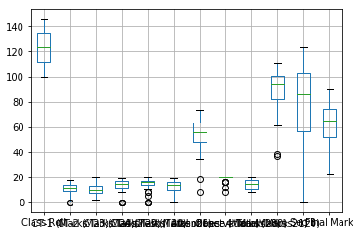
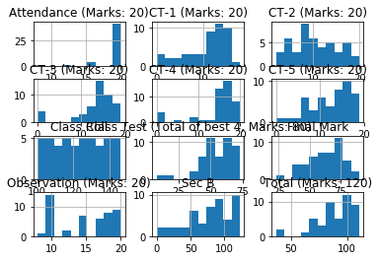
Box Plot
&
Histogram
dataframe1.boxplot()
dataframe1.hist()

Slide 21
Data Visualization tools
Scatter Plot
Box Plot
Time series analysis
Bar graph
Histogram
Pie chart
Line graph
Dot plot
Stem & Leaf

Slide 22
Scatter plot
When we need to find the relationship between two variables, we may draw scatter plot
Finding whether the variables are correlated (positive, negative or no correlation)

Slide 23
Histogram
https://matplotlib.org/gallery/statistics/hist.html

Slide 24
Box Plot
Determining the percentiles

Slide 25
Bar graph
30% & 70% marks

Slide 26
Scatter Plot

Slide 27
Box Plot
https://matplotlib.org/api/_as_gen/matplotlib.pyplot.boxplot.html

Slide 29
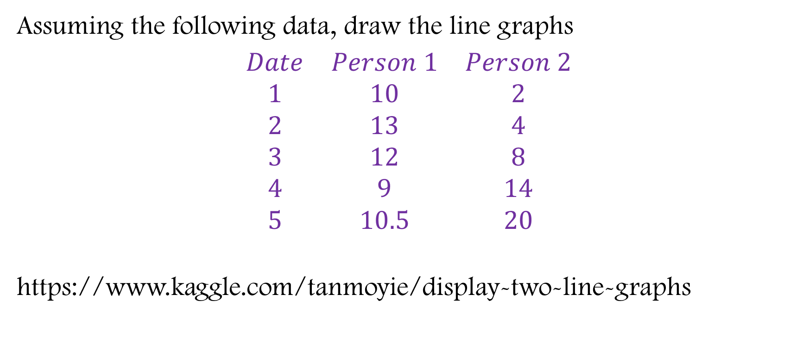
Line graphs
Assuming the following data, draw the line graphs
$\begin{matrix}Date & Person 1 & Person 2 \\ 1 & 10 & 2 \\ 2 & 13 & 4 \\ 3 & 12 & 8 \\ 4 & 9 & 14 \\ 5 & 10.5 & 20\end{matrix}$
https://www.kaggle.com/tanmoyie/display-two-line-graphs

Slide 30
Exploratory Data Analysis

Slide 31
Initial Raw data

Slide 32
Data preprocessing
Data Cleaning

Slide 33
Data after preprocessing

Slide 34
Find relationship between variables

Slide 35
Find the properties of certain variable

Slide 36
Simple Linear Regression in Python
Presented by Tanmoy Das
https://github.com/tanmoyie/Applied-Statistics

Slide 37
Requirement
Pandas & Statsmodels installed
I’ve run it in Spider IDE of Anaconda. If you don’t have them installed in your machine, you might end up running in kaggle.com as well

Slide 38
Dataset
https://archive.ics.uci.edu/ml/datasets/Communities+and+Crime+Unnormalized#

Slide 39
Python Program

